Slide 1
Build an agent with Azure AI Agent Service
Speaker name

Slide 2
Build an agent with Azure AI Agent Service
Name
Job title Company
Notes:
Hello and welcome to the Build an agent with Azure AI Agent Service workshop
This is a developer session
My name is XXXX
Building app with LLMs is astonishing – power and simplicity
We’ll explore building blocks for single and multi-agent scenarios
My goal for this session is that leave this session understanding the core concepts of agents and you'll be able to leverage Azure AI effectively for your own work.

Slide 3
Introduction
Setting the scene
Notes:
We’ll exploring the AI Agents.
Core concepts and talk about "what is an agent"
what sets them apart from just using LLMs for chat completion

Slide 4
Use case
Working for an e-commerce selling camping equipment
Want to analyse sales data
Notes:
We're an outdoor and hiking equipment company and sell online
We'll use the power of AI to analyze our sales data

Slide 5
How can an LLM
help us?
Notes:
At this point, we’re probably thinking how can LLM, a large language model help me with sales analysis process?
Well, let’s put it to the test, what if we craft a prompt on sales analysis, let’s see what it can do for us..

Slide 6
User
I work at an e-commerce selling camping gear, suggest how I can best analyze the sales data?
Response
To analyze your sales data effectively, consider using a combination of tools and techniques. Start with a data analytics platform like Excel, or more advanced tools like Tableau or Power BI.
Regularly visualize your data through charts and graphs to make insights more accessible.
Notes:
Today comfortable using LLMs to answer questions
Totally reasonable answer but also a bit useless
We ask questions
Gradually refine those questions
I’m driving the conversation
Until we reach our goal – the answer to our question
This can be complex and a lot of work
So, here's where agents come into play!

Slide 7
Agent
Semi-autonomous software that can be given a goal and will work to achieve that goal without you knowing in advance exactly how it's going to do that or what steps it's going to take.
Notes:
So, what differentiates AI conversations and Agents
There are many definitions of an Agent
This is the definition we’ve settled on.
Simple as data analysis
Complex as onboarding a new hire
Semi-autonomous software that can be given a goal and will work to achieve that goal without you knowing in advance exactly how it's going to do that or what steps it's going to take.

Slide 8
What are we building?
Notes:
Use case where we sent a prompt to get help with the sales process, for Contoso ecommerce.
Build an agent rather than just interacting with a pre-trained LLM.
For this app we’ve simple goals
There are many agent frameworks and APIs – LC, SK, AutoGen, Crew AI, LangGraph
Azure AI Agent Service and evolution of the Assistants API
Azure AI service which makes it easier to build agentic apps.
Stateful, manages context, designed to reduce the complexity of building agent app

Slide 9
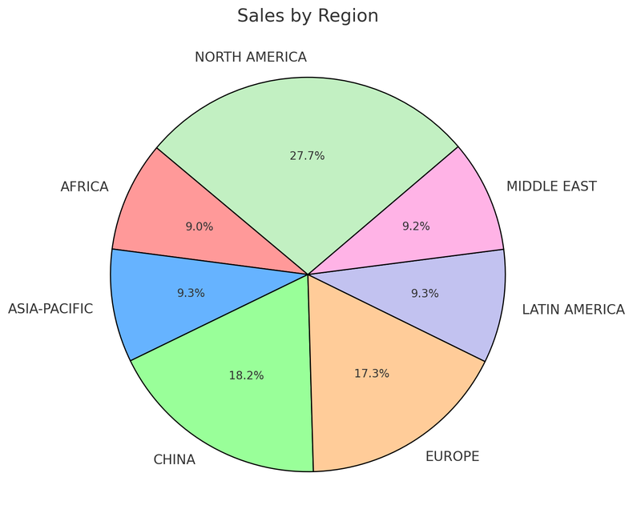
AI Agent Service in Action
Step 1: Create an Agent
Step 2: Create a Thread
Step 3: Run the Agent
Step 5: Check the Run status
Step 6: Display the Agent’s Response
Agent
Contoso Sales Agent
Instructions: You are an advanced sales analysis agent for Contoso, specializing in assisting users with sales data inquiries
Thread
Sales analysis
Run 1
User’s message
Tell me the total sales by region
1
Function Calling Tool
Query SQLite DB
Model
Agent’s message
Here is the sales:
Europe: $15478.00
America: $78792.00
2
Create message
Your data (optional)
Azure AI Search
Files (local or Azure Blob)
User’s message
Show as a pie chart
Run 2
Tools (optional)
File Search Code Interpreter
Function Calling Bing Search Microsoft SharePoint
Microsoft Fabric Azure Logic Apps
Azure Functions
OpenAPI 3.0 specified tools
1
Code Interpreter Tool
Create a pie chart
Agent’s message
2
Create message
Notes:
This slide has lots of annimations
So, a bit more of a drill down
High level – this is how the AI Agent Service works
Create/define agent,
Create a thread which is a unit of conversation
Run the Agent
Check status till complete
Show output
Break this down futher

Slide 10
Workshop
Let's get started!
https://workshop-ai-agents.globalaibootcamp.com/

